Slide 1










Innovation Practices
Second Review

Slide 2
Team members
Indra Shekar G (19z219) Sanjai M (19z241) Soumen Saha (19z245) Vivekanandhan (19z261) Manoj S (19z263)
Mentor
Ms. A. Bharathi, Asst. Professor Department of Computer Science and Engineering, PSGCT

Slide 3

Presentation Flow
1
Problem Statement
4 Modules Completed
2
Review 1 Questions
Progress & Remaining Work
5
3 Methodology
6 References

Slide 4
Problem Statement
Capturing content & particulars in any type of pharmaceutical bill with any format and converting it into a formatted invoice
Healthcare Document Data Capture

Slide 5
Questions Asked in First Review
What are the datasets we used and how did you find it?
Initially we made use of IAM Handwritten Dataset for training our model. We created our own dataset by collecting bills’ images from google and nearby pharmacies.
What is the model and techniques used for pre-processing the input images?
9 image pre-processing techniques are used on digital images. We created a CRNN model using the IAM dataset.
Colored image to grayscale
Noise Removal (blurring)
Thresholding
Erosion
Morph
Canny edge detection
Skew Correction
Template matching
Boxing

Slide 6
What is the accuracy you achieved and how many epochs you ran?
We got low accuracy at the initial stage (10 epochs , ctc_loss = 2.99) and got increased accuracy on running the model in higher epochs (50 epochs , ctc_loss = 1.72).
How is the industry guiding us in this project?
Their engineering team will be providing us datasets (including Spanish and Portuguese pharmacy bill images) and model recommendations.

Slide 7

Methodology
The models used on the available datasets like IAM dataset are evaluated with their accuracies and picking the best one.
The input bill images are pre-processed using OpenCV and converted it into formatted digital document using the model we built up.
Text is extracted from the digital document and mined into an well-formatted invoice.

Slide 8
Modules Completed
Pre Processing
Model Training
Model Testing
Upcoming Modules:
Topic Modelling
Post Processing

Slide 9
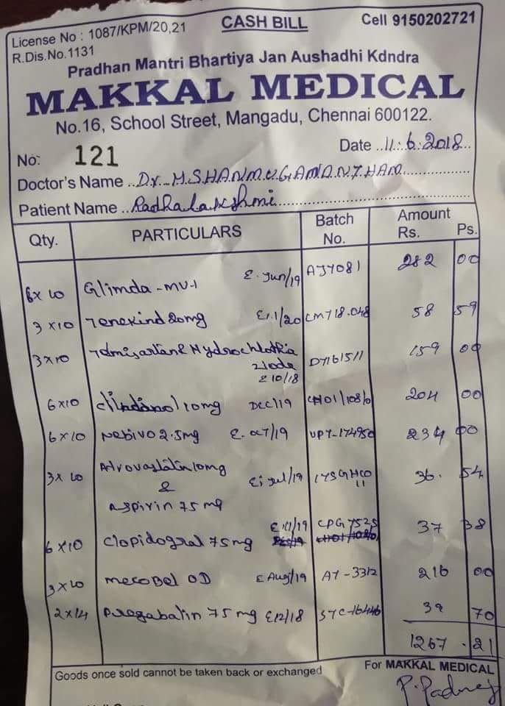
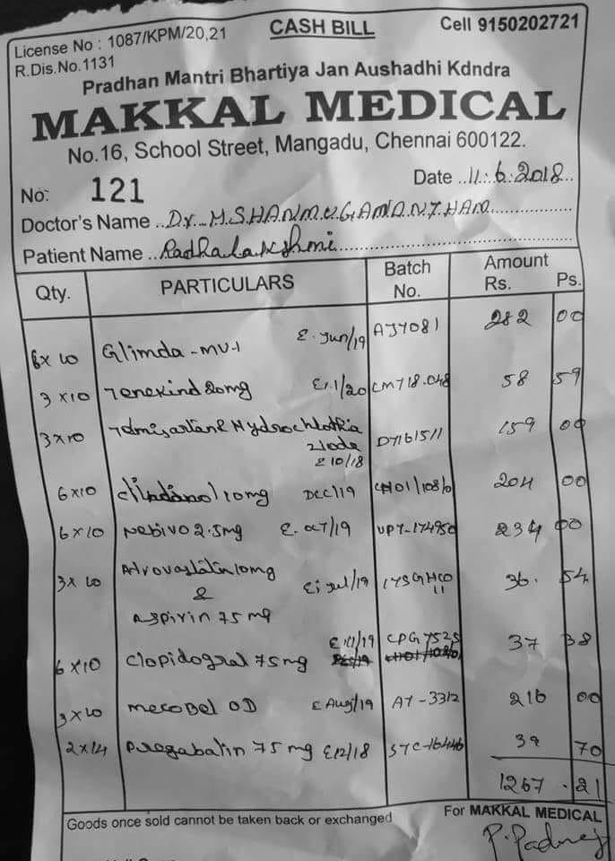
Progress
1. Pre-processing of bills
1.1 Normal bill image to grayscale image:

Slide 10
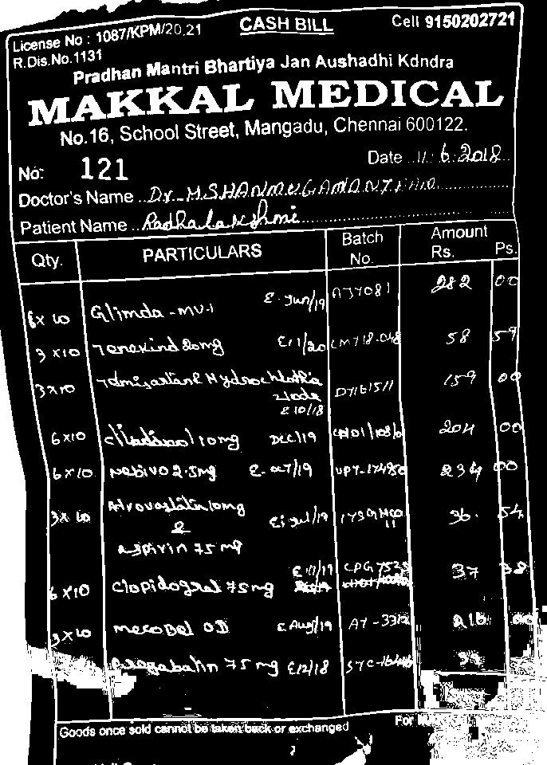
1.2 Grayscale to binary conversion using thresholding

Slide 11
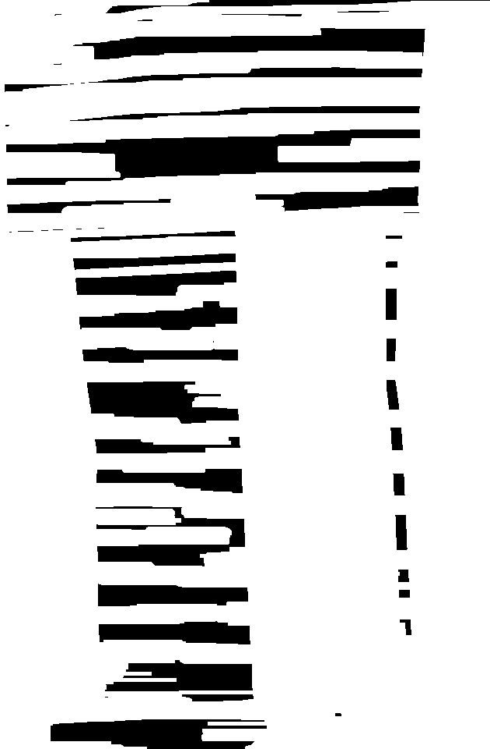
1.3 Binary to dilated image

Slide 12
2. Extracting text from the image using Keras - OCR
Keras-OCR provides out-of-the-box OCR models and an end to end training pipeline to build new OCR models.
Here, Keras-OCR is used to detect the text from the image and extract them into individual word images.

Slide 13
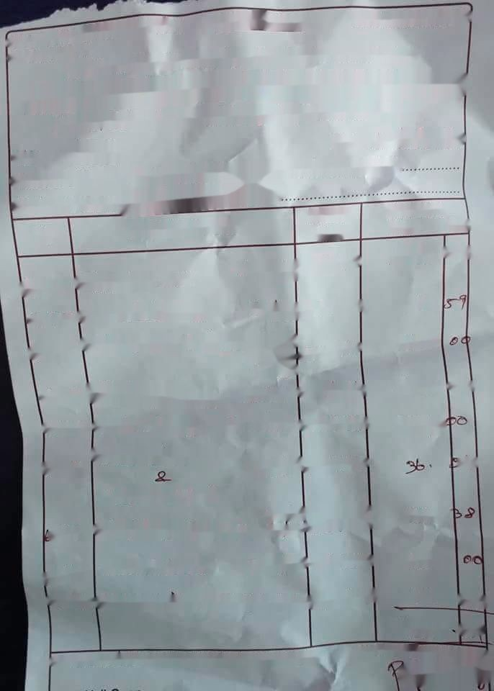
2. Extracting text from the image using Keras - OCR
Original image
After text extraction

Slide 14












Individual word images retrieved:

Slide 15
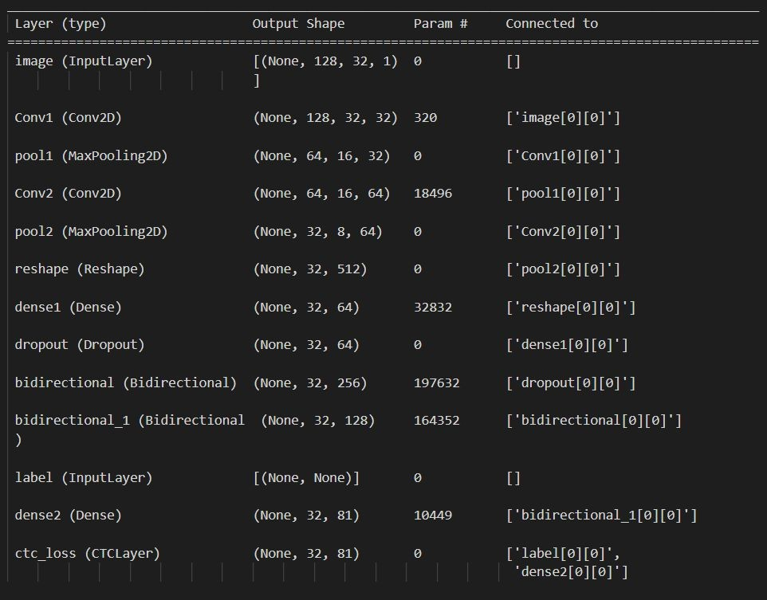
3. MODEL TESTING
Model used: CRNN
Dataset: IAM Dataset
No. of epochs: 50

Slide 16
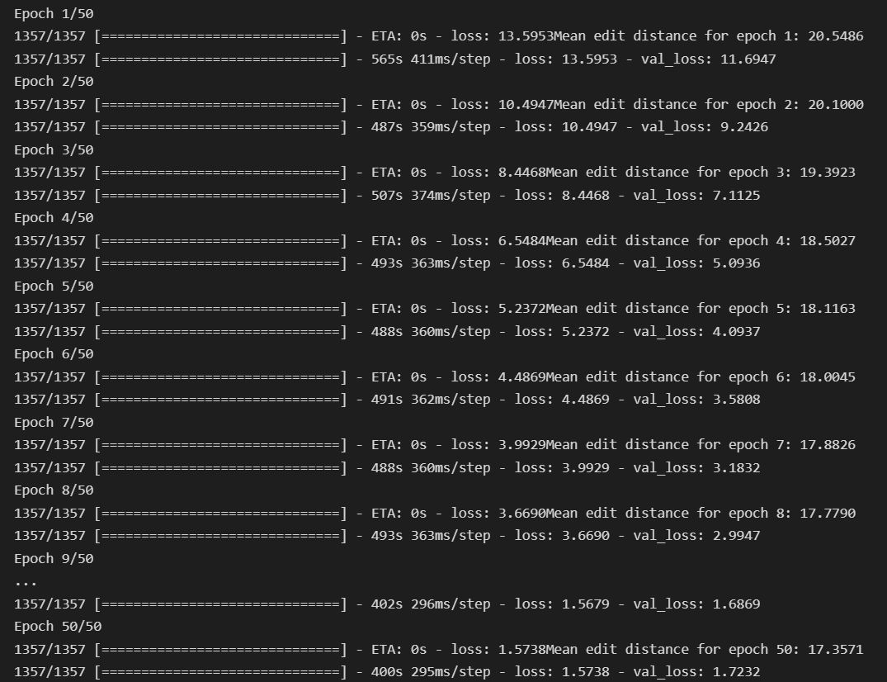

Slide 17
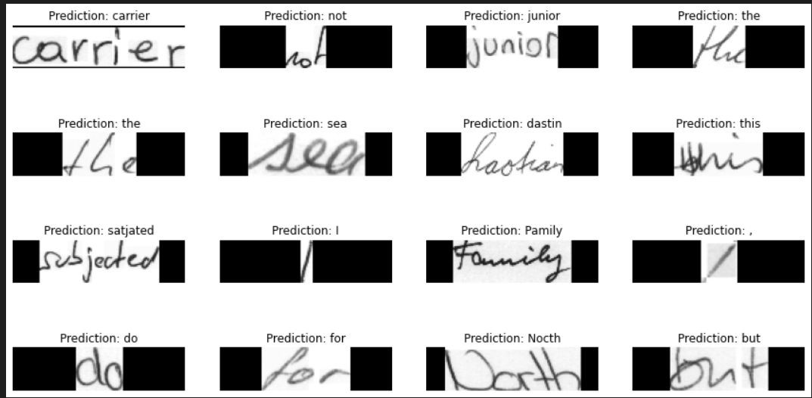
Word Predictions:

Slide 18
Remaining Work
NLP
Topic modeling (topic information retrieval from text)
Post processing
Transforming the predicted text into a particular format

Slide 19
References
https://blog.hexstream.com/process-handwritten-text-using-python-and-cloud-vision
https://medium.com/@derrickfwang/printed-and-handwritten-text-extraction-from-images-using-tesser act-and-google-cloud-vision-api-ac059b62a535
https://github.com/DerrickFeiWang/HandwritingRecognition_GoogleCloudVision
https://towardsdatascience.com/build-a-handwritten-text-recognition-system-using-tensorflow-2326a34 87cd5
https://www.researchgate.net/publication/346701461_End-to-end_Handwritten_Paragraph_Text_Reco gnition_Using_a_Vertical_Attention_Network
https://keras-ocr.readthedocs.io/en/latest/examples/using_pretrained_models.html
https://towardsdatascience.com/remove-text-from-images-using-cv2-and-keras-ocr-24e7612ae4f4

Slide 20



Thank You

